Slide 1
Ways to Pay for College
Basics of Financial Aid and the
2024-2025 FAFSA

Slide 2
Sources of Financial Aid
1. Federal Aid
2. State Aid
3. Institutional Aid
4. Outside Aid

Slide 3
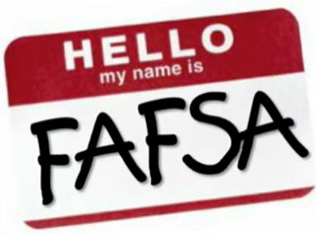

Free Application Federal Student Aid (FAFSA)
FAFSA is free to complete
Apply by March 1st
FAFSA opens in December
(Usually October 1st)
Schools have deadlines
Apply each year

Slide 4
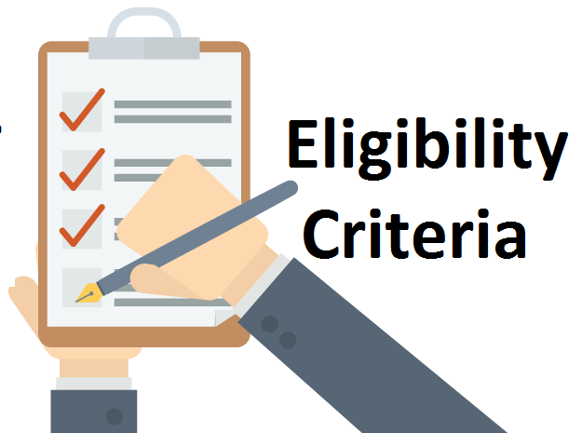
FAFSA Eligibility Criteria
You must be a U.S. citizen or eligible non citizen. https://studentaid.gov/understand-aid/eligibility
You must have a high school diploma, GED or completed a homeschool program approved under state law.
You must be enrolled in an eligible degree or certificate program at the college you plan to attend.

Slide 5
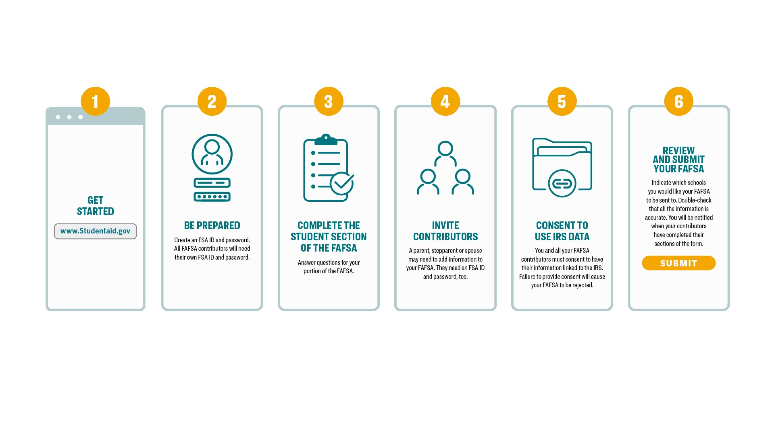

Slide 6
2024-2025 FAFSA Overview
Major changes
  - Expected Family Contribution is now Student Aid Index
    No SAI split for number in college
    SAI can be negative
    Change as to who is reported as a parent in case of divorce/separation/unmarried
  - An invitation-only FAFSA form
    Dependent students must invite their parent(s) to contribute to their form if parent information is required.
- Financial Aid Direct Data Exchange (required)

Slide 7
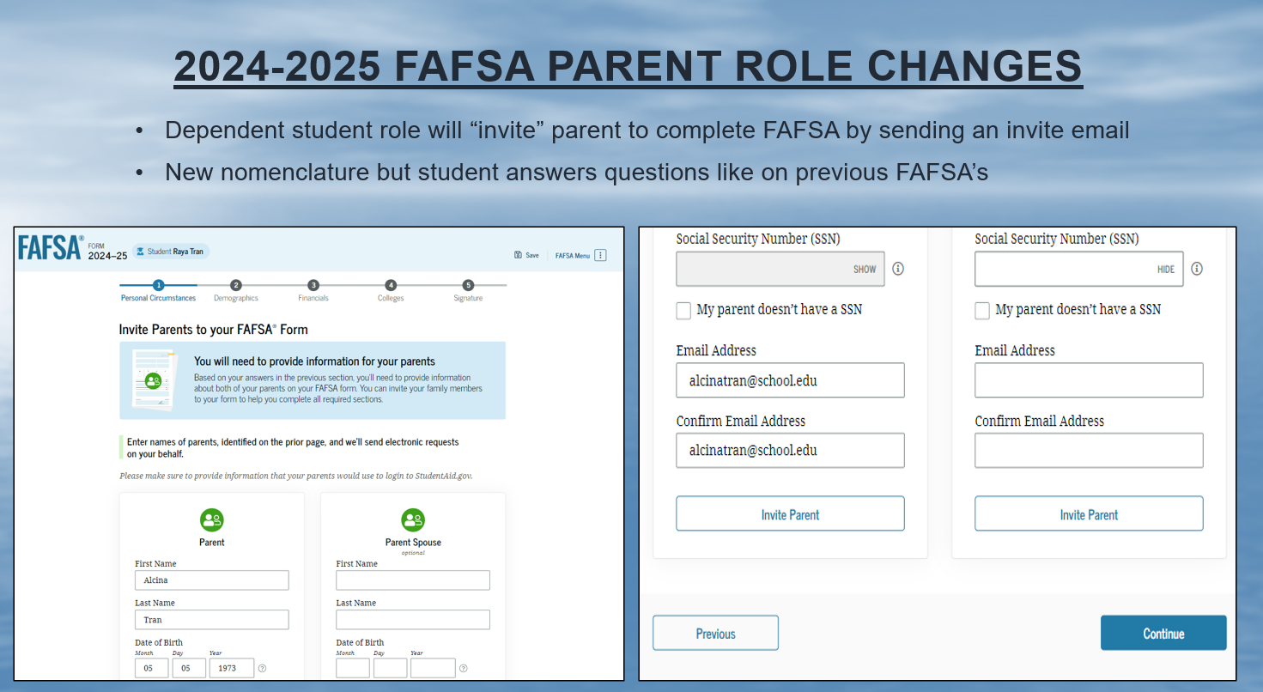

Slide 8
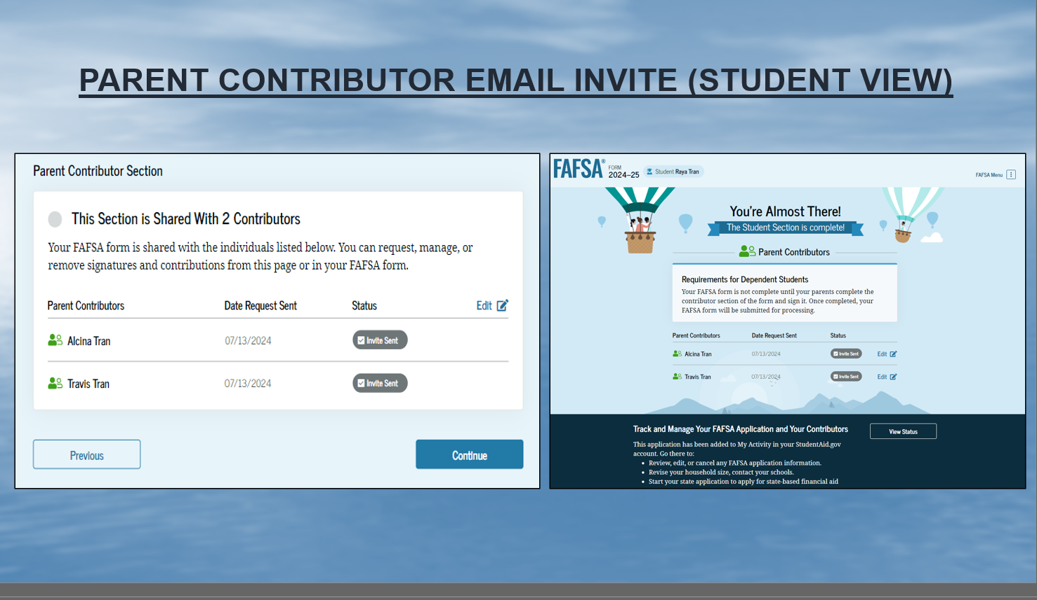

Slide 9
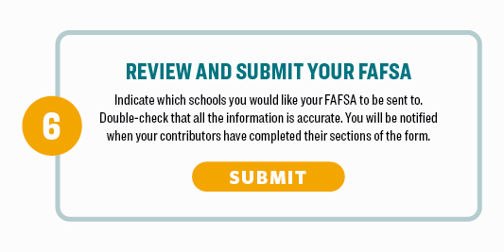

Slide 10
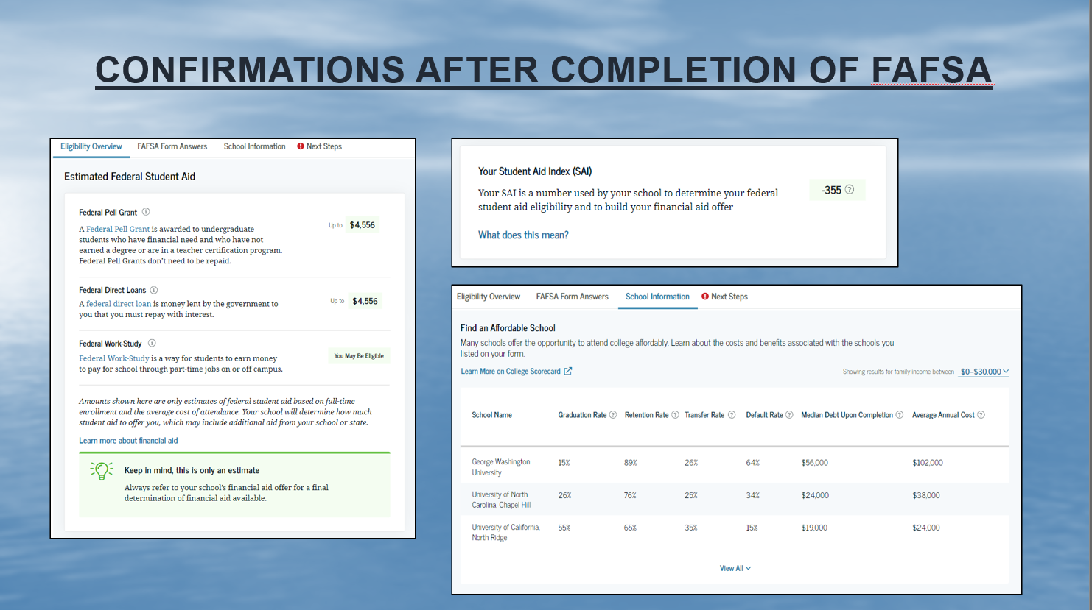

Slide 11

2024-2025 FAFSA Quick Tips
Create a Federal Student Aid (FSA) ID and Password at www.studentaid.gov.
Utilize the IRS Data Retrieval Tool.
Watch for the confirmation page that says your FAFSA was submitted.
Do not report unnecessary assets like retirement accounts, home equity, or personal possessions.
Be truthful as schools can verify information.
Need help? Use the help functions within the FAFSA (including live chat) or call 1-800-4-FED-AID.

Slide 12

State of Maryland
The State of Maryland Higher Education Commission (MHEC) awards over $100 million in need-based grants and merit scholarships through the state's 22 programs each year.
Complete the FAFSA by March 1st every year.
Create an MDCAPS account at www.mhec.state.md.us
Howard P. Rawlings Education Assistance Grant (EAG)
Howard P. Rawlings Guaranteed Access Grant (GAG)
Delegate & Senatorial Scholarships
Maryland Community College Promise Scholarship

Slide 13
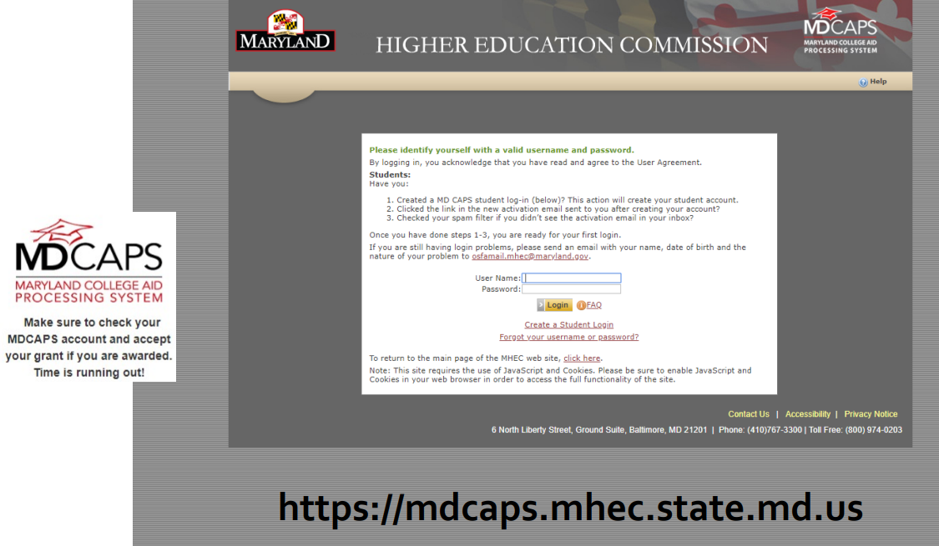
State of Maryland (MDCAPS) Website
MHEC will invite you to join MDCAPS once their office receives your FAFSA application.
Complete the FAFSA by March 1st every year.

Slide 14
State of Maryland (Promise Scholarship)
The Community College Promise Scholarship is a last dollar scholarship that is available to students who enroll at a Maryland community college.
Complete the FAFSA by March 1st every year.
Create an MDCAPS account at www.mhec.state.md.us
Enroll in a full-time or part-time credit-bearing degree program.
Eligible for in-state tuition and enrolled at your local community college.
Meet GPA requirements and maintain a minimum 2.5 GPA after enrollment.
Annual income of $100,000 if single-parent household, $150,000 if two-parent household.
Eligible students can receive up to $5,000 to cover any remaining tuition and mandatory fees per academic year.

Slide 15


Maryland State Financial Aid Application (MSFAA)
The MSFAA is available to applicants who are ineligible to receive federal aid and allows qualified children of undocumented immigrants who qualify for in-state tuition (Maryland Dream Act),to receive Maryland grants and scholarships.
Complete the MSFAA through the MDCAPS portal by March 1st every academic year to be considered for all available scholarships.
Eligible for various Maryland State scholarships and grants.
FAQs for the MSFAA are available on MHEC’s website.
Maryland Dream Act – allows undocumented immigrants to receive in-state tuition at AACC. The qualification for this special rate is available on AACC website.
https://mdcaps.mhec.state.md.us/

Slide 16
Institutional Scholarships
Visit your school’s website or contact your college’s financial aid office for information regarding scholarship opportunities… now.
Apply early and be aware of deadlines, many are fast approaching.
Some scholarships are awarded in the school application process.
The AACC Foundation has over 200 scholarships and awards nearly $1,000,000 annually. Application opens March 1st, and awards throughout the year.
Scholarships for Continuing Education programs are available.

Slide 17

How to apply for a
Start looking and applying for outside scholarships as soon as October… (the earlier you apply, the less the competition) and watch the deadlines.
Use as many resources as you can find:
  High School Counselors (NAVIANCE)
  Free scholarship searches are available at studentaid.gov/scholarships
  U.S. Department of Labor’s FREE scholarship search tool. (CareerOneStop)
  Review for legitimate scholarship search sites
  NEVER PAY FOR SCHOLARSHIP SERVICES
Take time to create 2-3 really good essays (once done most essay questions are basically the same and you can copy & paste).
Reach out to community groups and organizations you are affiliated with, as well as employers and local businesses

Slide 18
How Much Does College Cost?
Tuition and Fees Cost of courses and required fees only.
COA Cost Of Attendance is made up of tuition, fees, room and board, books, supplies, transportation, etc.
EFC (soon to be SAI) Expected Family Contribution (Student Aid Index) determines your funding eligibility based on the information reported on the FAFSA application.
Financial Need is the difference between the Cost of Attendance and your Expected Family Contribution. (COA – EFC (SAI) = Financial Need)

Slide 19
Types of Student Financial Aid
  Gift Aid: Grants do not need to be paid back.
  Federal and State Grants
  State, Institutional, and Outside Scholarships
  Self Help Aid: Loans need to be paid back.
  Direct Subsidized and Unsubsidized Loans: $5,500 - $10,500 (depending on eligibility and dependency status)
  Federal Work-Study: Student work on campus. Depends on school availability
Other Sources:
  VA, tuition assistance, Americorp, etc
Parent Resources:
  Direct PLUS Loan for Parents: COA minus other aid received (more common at 4-year institutions)

Slide 20

How Do I Apply for Financial Aid?
Free Application for Federal Student Aid (FAFSA)
StudentAid.gov
AACC Federal School Code: 002058
Which FAFSA?
2023-24 – the current school year
2024-25 FAFSA – next Fall
AACC Scholarships
www.aacc.edu/scholarships
Maryland Higher Education Commission (MHEC)
mhec.state.md.us

Slide 21
Financial Aid Resources
AACC Financial Aid Office
If you have any further questions
Contact us! If you are interested in attending AACC or have general questions about financial aid.
faoutreach@aacc.edu
www.aacc.edu/aid
410-777-2203
Federal Student Aid (FSA) Channels
YouTube: @FederalStudentAid
Instagram: @FederalStudentAid
Twitter: @FAFSA
Federal Student Aid (FSA) Information Center
Live Chat: https://studentaid.gov/help-center/contact
Email: https://studentaid.gov/help-center/contact
1-800-433-3243

Slide 22
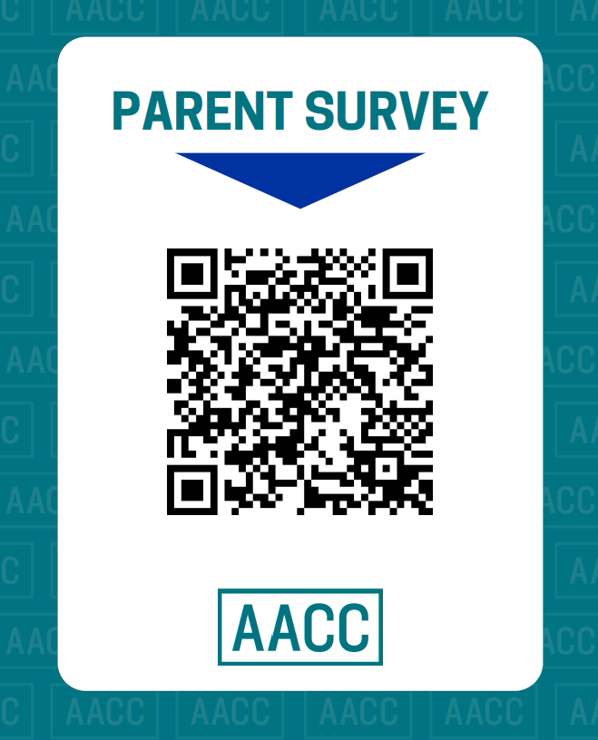
Parents!
Please complete a short survey so AACC can learn how to better support you

