Slide 1
Preparing for the PRD

Slide 2
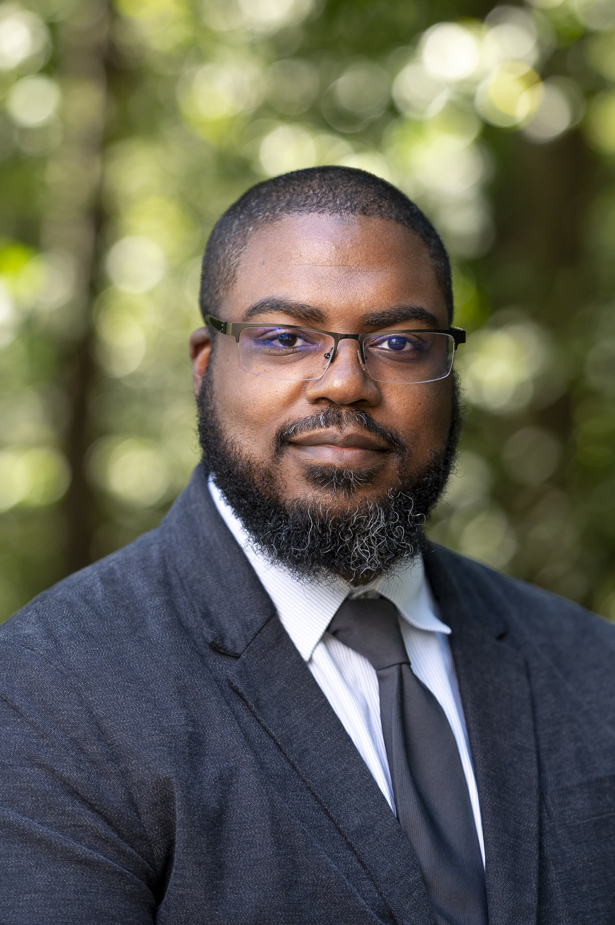
My Contact Information
(410) 777-2142
EMDUBOSE@AACC.EDU
ELIAS DUBOSE

Slide 3
Agenda
What is PRD?
How you can attend AACC
Differences Between High School and College
Enrollment Process/What you should do before PRD
Application
Placement
ECAP (Rising Juniors and Seniors)
FAFSA (For Graduating Seniors)
Key Dates

Slide 4
What is a PRD?
Personal Registration Day, or PRD, is an opportunity for high school students to meet with advisors, plan, and register for classes for the upcoming Summer and Fall terms.

Slide 5
EARLY COLLEGE ACCESS PROGRAM (ECAP)
A way for high school students to take college classes and earn credit while still enrolled in high school
Eligibility
Age of 16 or older*
2.0 unweighted GPA

Slide 6
Gifted and Talented
If you will be younger than 16 by the start of classes, please meet with your counselor FIRST before proceeding with the steps discussed.
You will need approval by Assistant Superintendent Mary Tillar
If approved, you will be required to attend an information session with AACC Admissions Director Cassandra Moore for final approval

Slide 7
Graduating Seniors
Once you graduate high school, you will no longer be eligible for ECAP
PRD will assist you to fully transition to AACC
Taking classes to transfer
Intending on earning a Certificate or Degree

Slide 8
Differences Between High School and College
Communication is Key
Deadlines are FIRM
NO GOOD FAITH EFFORT OR REDO’S
ABSENCES
REQUIRES MORE STUDY TIME
Dropping & Withdrawing (Academic Calendar)
STUDENT SUPPORTS

Slide 9
Student Support Services
Advising
Disability Support Services
Library
Military and Veteran Resource Center
Student Achievement and Success Program (SASP)
Virtual Writing Center
Campus Dining
Black Male Institute
Student Government Association

Slide 10
Where Do I Get Started?
Let your counselor or AACC Transition Advisor know that you want to attend the PRD
Complete the AACC Application

Slide 11
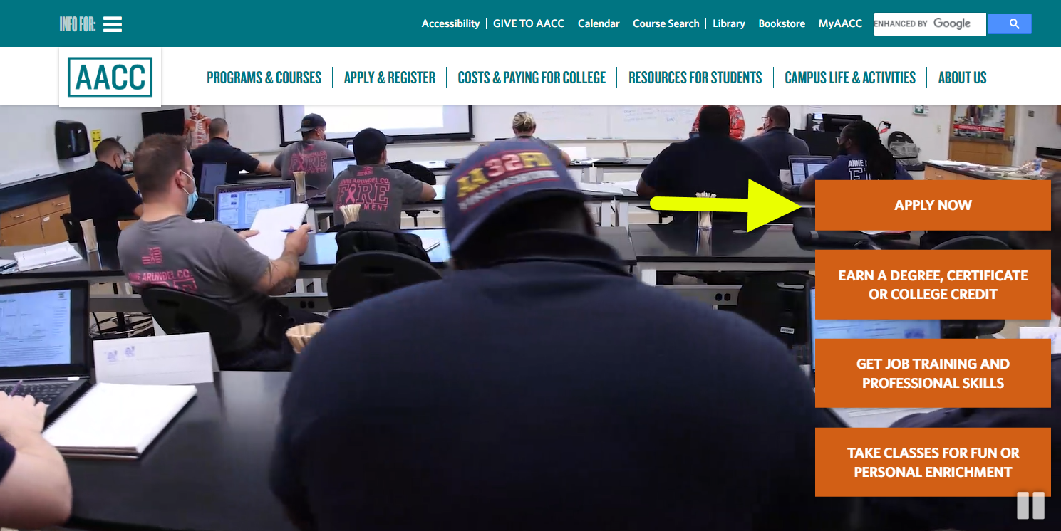
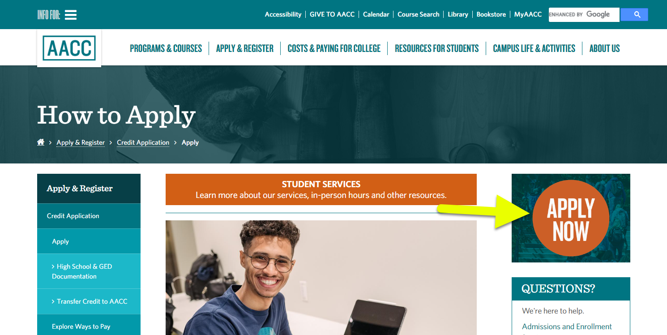
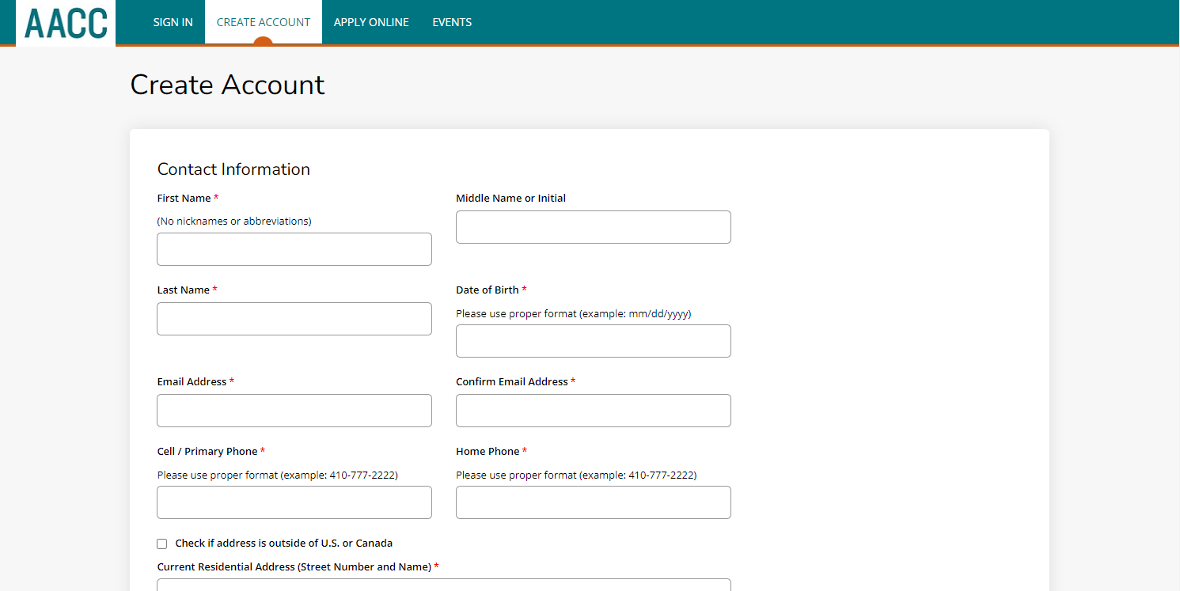
Completing the Application

Slide 12
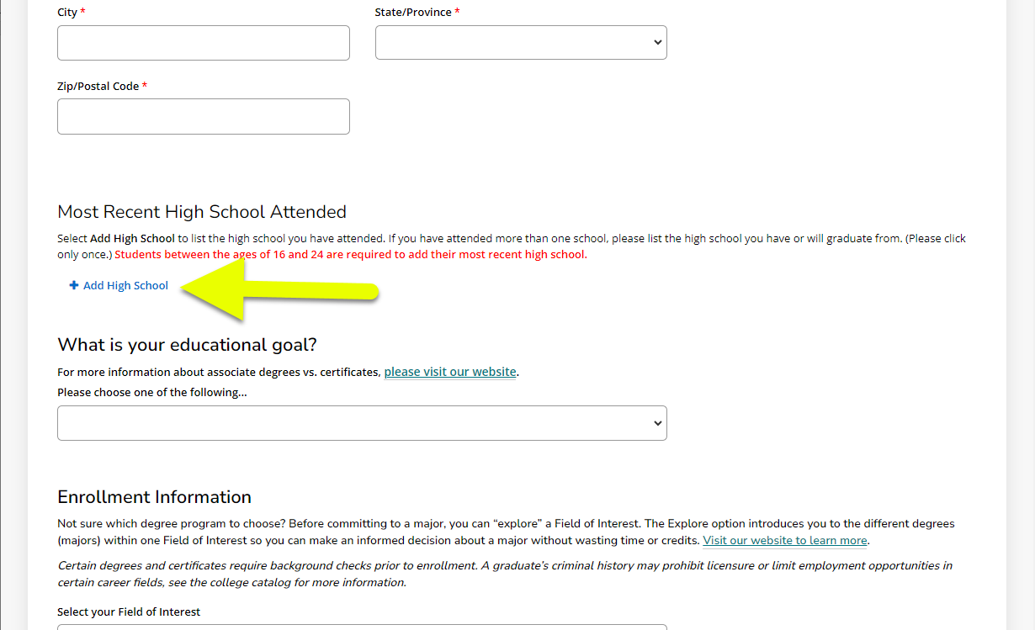
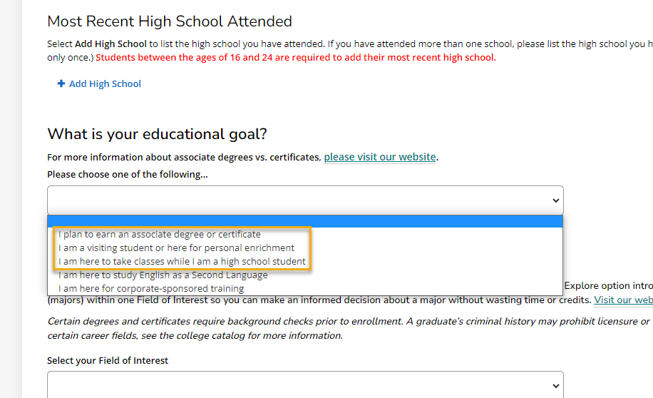
Key Things to look for on the Application

Slide 13
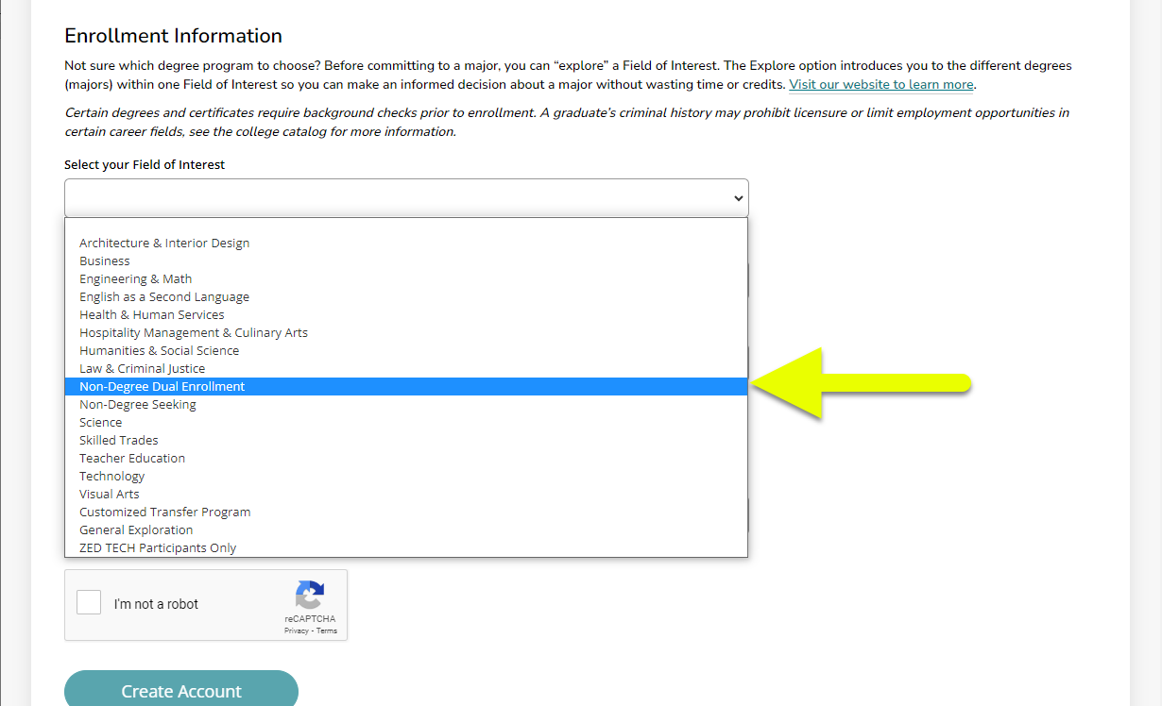
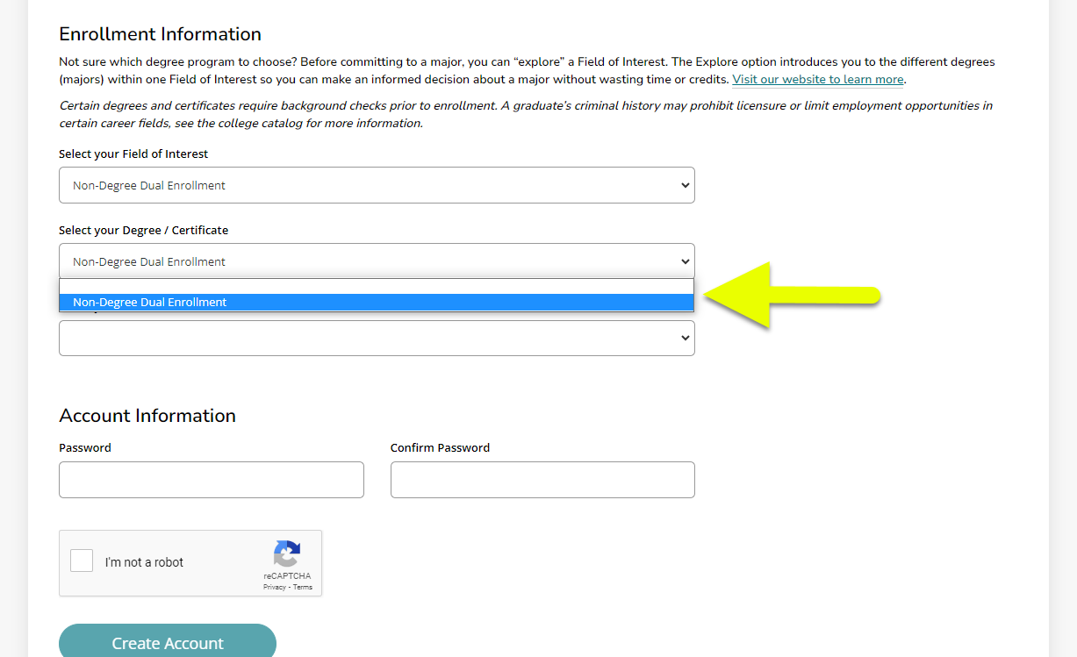

Slide 14
Financial Aid (SENIORS)
Can be changed later through the Records Office*

Slide 15
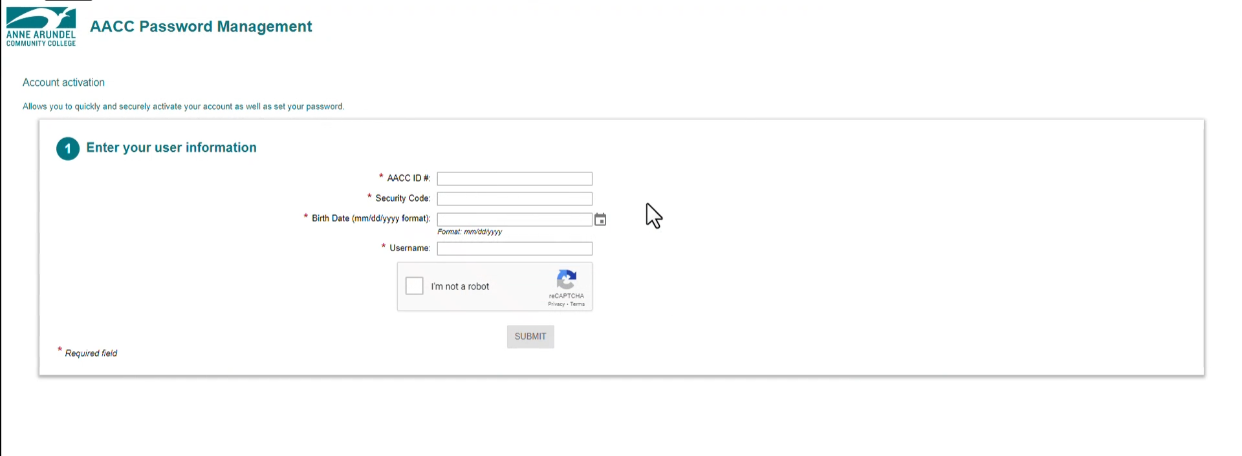
Activating Student Account

Slide 16
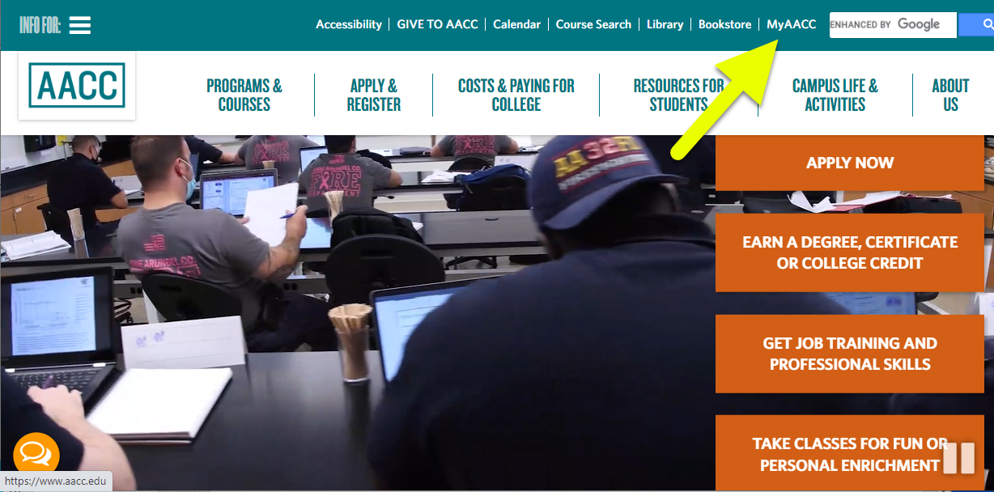
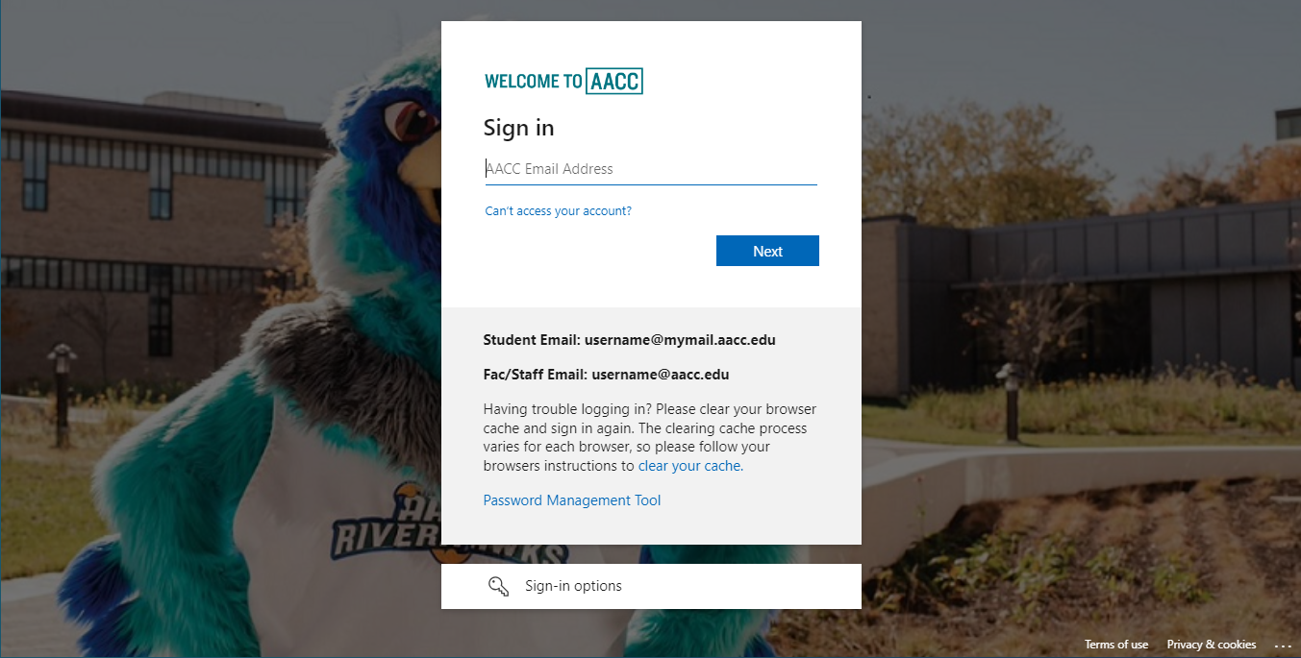
Accessing the MyAACC Portal

Slide 17
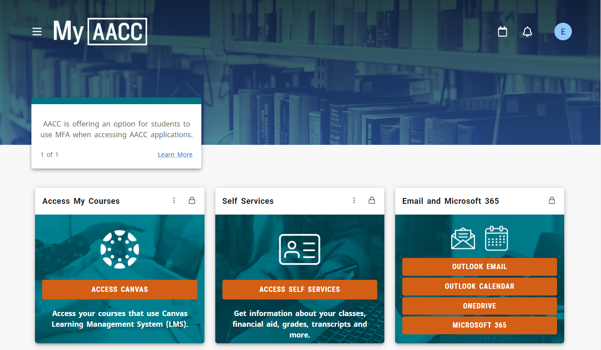

Slide 18
Placement
Evaluating your ability to take College English and College Math
Multiple Ways to Determine:
Accuplacer Placement Test
Standardized Test Scores (SAT, ACT, etc.)
Rising Seniors: Completed Junior year transcript
AP Exam Scores of 3 or Greater

Slide 19
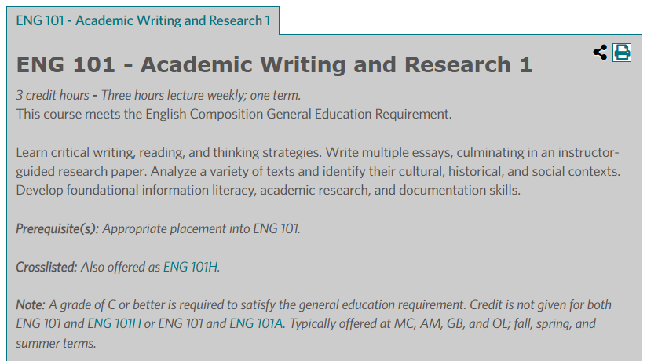
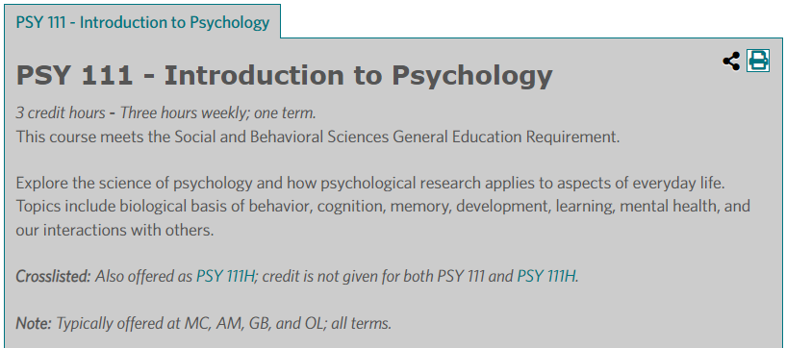
Why Does Placement Matter?

Slide 20
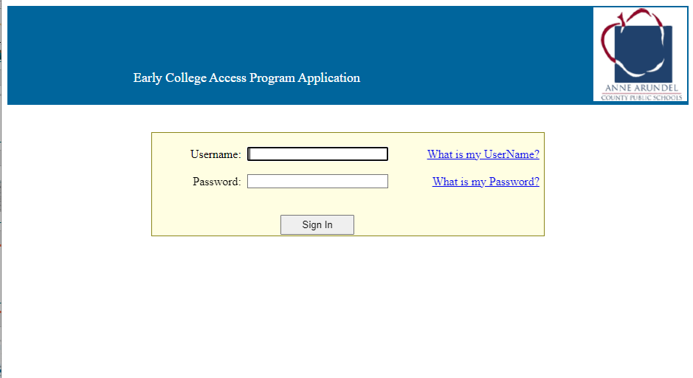
ECAP FORM
Sign into the ECAP Application webpage
Download the prepopulated form

Slide 21
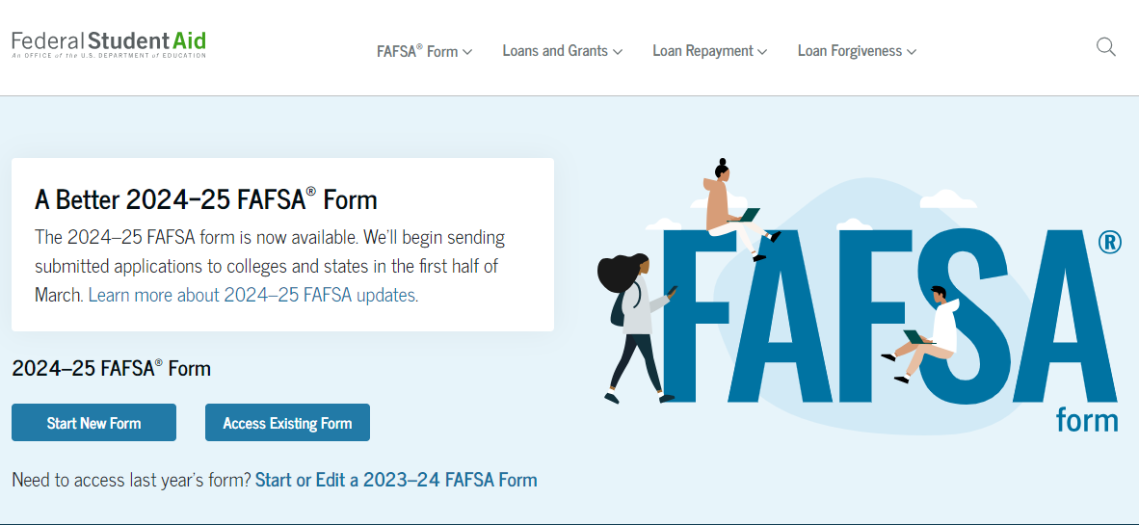
FAFSA (SENIORS ONLY)
HTTPS://STUDENTAID.GOV

Slide 22
Personal Registration Day (PRD)
Prior to the PRD, you will sign up for a 45-minute meeting with an advisor
On the day of your PRD, you will meet with them to assist you in selecting your class(es)
Financial Aid Staff will also be available to work with Seniors who have submitted their FAFSA

Slide 23
Key Upcoming Dates
Accuplacer – Available Now
PRD– April 16, 2024

Slide 24
PRD Checklist
Talk to your Counselor about PRD
Complete the Application
(Seniors) Complete the FAFSA
Submit Placement
Attend & Complete Accuplacer
AND/OR
Submit Test Scores
Attend PRD

Slide 25
My Contact Information
(410) 777-2142
EMDUBOSE@AACC.EDU
ELIAS DUBOSE

