Slide 1
Ways to Pay for College Basics of Financial Aid and the FAFSA

Slide 2
We will talk about:
Federal student aid
State student aid
Student aid from colleges
Scholarships from other sources

Slide 3
What is financial aid?
Money to pay for college or career school
Grants
Work-study
Loans
Scholarships

Slide 4
Who can get federal student aid?
U.S. citizen or permanent resident
High school graduate/GED holder
Eligible degree/certificate program
Valid Social Security number
Males registered for Selective Service
Satisfactory academic progress in college/career school

Slide 5
How much federal student aid could you be awarded?
In general, depends on your financial need.
Financial need determined by Expected Family Contribution (EFC) and cost of attendance (COA)
EFC comes from what you report on FAFSA® (Free Application for Federal Student Aid)
COA is tuition, fees, room and board, transportation, etc.
COA – EFC = financial need

Slide 6
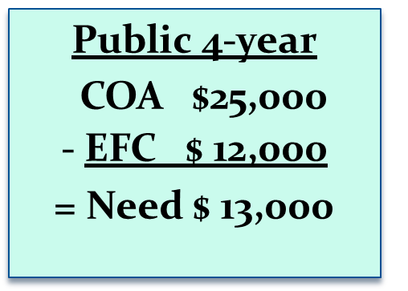
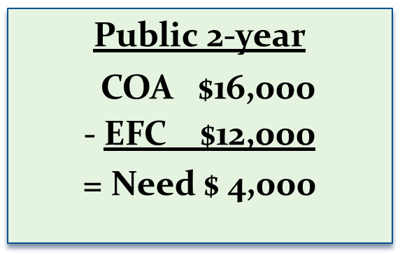
Need and Eligibility Depend on Cost

Slide 7
How much federal student aid could you be awarded (Continued)?
Maximum amounts for the major programs for a dependent freshman in 2018-2019:
Federal Pell Grant: $6,095
Federal Work-Study: depends on funds available at school
Direct Subsidized and Unsubsidized Loans: $5,500 total
Direct PLUS Loan (for parents): COA minus other aid received
For early estimate, use FAFSA4caster:
Go to fafsa.ed.gov, click “Types of Aid” and scroll halfway down the page

Slide 8
Overview of State Programs
Need-based Programs
Legislative Programs
Unique Population Programs
Other State Aid Programs
Howard P. Rawlings Educational Assistance & Guaranteed Access Grant (Need Based Program)
Part-Time Grant (Need Based Program)
www.mhec.state.md.us

Slide 9
Legislative Programs
Senatorial and Delegate Scholarships
Senatorial scholarships - file FAFSA by March 1 and demonstrate financial need.
Delegate scholarships – FAFSA may not be required.
Some awards are renewable for an additional 3 years.
Contact your Senator or Delegate for application and renewal procedures.
Note: Senators and delegates have the option to award; some do not select recipients but put their funds into other programs administered by OSFA

Slide 11
Maryland Promise Scholarship
“Last dollar” scholarship
Maximum annual award: $5,000 per recipient or the actual tuition, whichever is less
Must work in Maryland for the same number of years they received the scholarship (within one year of graduation)
Will convert to loan if service requirement is not met or if student fails to receive a vocational certificate, certificate, or associate’s degree while receiving the scholarship
https://www.aacc.edu/newscenter/maryland-promise/

Slide 12
Maryland Promise Scholarship
(Continued)
How to apply:
Submit FAFSA
Apply annually with MHEC
To be eligible for consideration, students must:
Have annual adjusted gross income of no more than $100,000 (single or single-parent household) or $150,000 (married or two-parent household).
Enroll within 2 years of graduating high school or completing GED.
Have earned an overall high school GPA of 2.3.
Be enrolled in a credit program (certificate or associate degree).
Enroll in at least 12 credits per semester.
Maintain a 2.5 GPA.
Funding will be limited.

Slide 13
Scholarships
Contact your college financial aid office for information regarding aid and scholarships.
AACC scholarship application opens on February 1.
To apply, visit www.aacc.edu/scholarships
AACC Foundation Scholarships - Over 200 scholarships with one application
Free scholarship search at
StudentAid.gov/scholarships

Slide 14
How do I apply for federal student aid?
Fill out your FAFSA at fafsa.gov
Apply on or after October 1 but as early as possible to meet all deadlines.
State deadlines are at fafsa.gov
School deadlines are listed on schools’ websites.
Need help? Use the help functions within the FAFSA (including live chat) or call 1-800-4-FED-AID.
Don’t forget: watch for the confirmation page that says your FAFSA has been submitted, THEN log out.

Slide 15
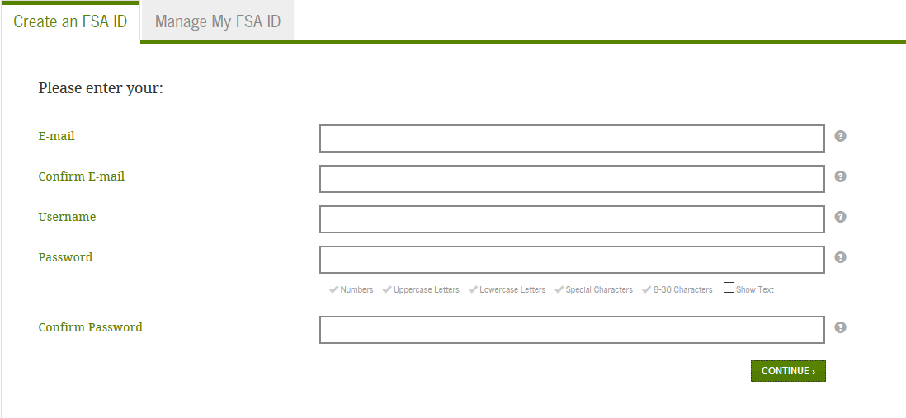
Creating an FSA ID

Slide 16
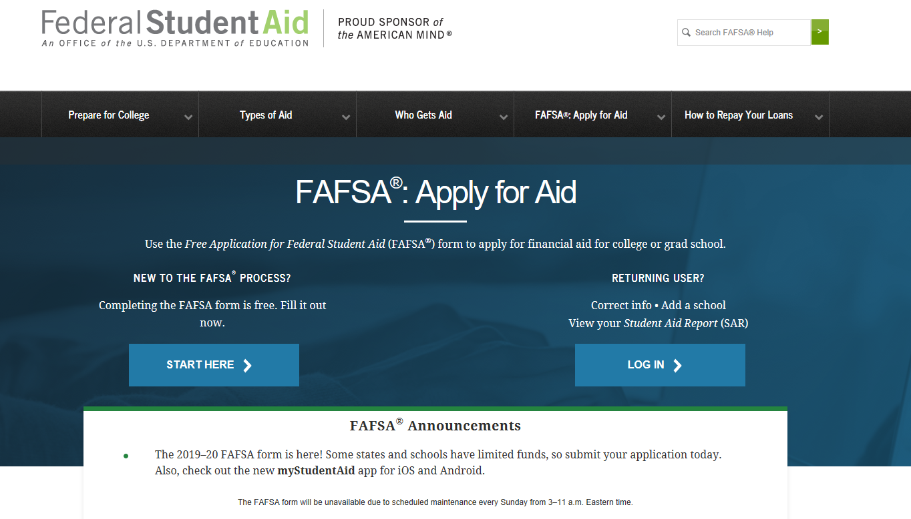

Slide 17
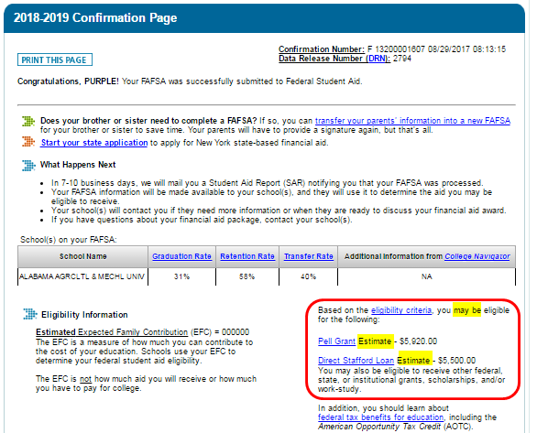

Slide 18
Questions?
Visit the AACC Financial Aid Office
Financial Aid & Veterans Benefits Main Office
Student Services Building, Room 160, Arnold
Financial Aid at Arundel Mills
7009 Arundel Mills Circle, Room 105F, Arundel Mills
Financial Aid at Glen Burnie Town Center
101 N. Crain Hwy, Room 209, Glen Burnie
410-777-2203
finaid@aacc.edu

